Slide 1

Network Security
CS-411
Lecture # 02

Slide 2
Attackers
Six types:
Ethical Hackers/ White hat
Hackers/ Black Hat/ Crackers
Script Kiddies
Spies
Employees
Cyberterrorists

Slide 3
Attacks
Social Engineering
Phishing
Shoulder surfing
Dumpster Diving
Passwords
Weak/Same Passwords
Brute force
Dictionary attack
Rainbow Table
Software Exploitation (Buffer Overflow)
Weak Keys
Notes:
John the ripper

Slide 4
Attacks
Mathematical Attacks(Cryptanalysis)
Birthday Attack
Identity Attacks
Man in the Middle Attack
Replay Attack
TCP/IP Hijacking Attack (ARP Spoofing)
Denial of Service Attack
Notes:
ICMP protocol to send ping – smurf attack
There are 3 types of DDoS Attacks:
Volume-based attacks,
Protocol attacks, and
Application layer attacks.
Following are the methods of doing DDoS attacks:
UDP flood
ICMP (Ping) flood
SYN flood
Ping of Death
Slowloris
NTP Amplification
HTTP flood

Slide 5
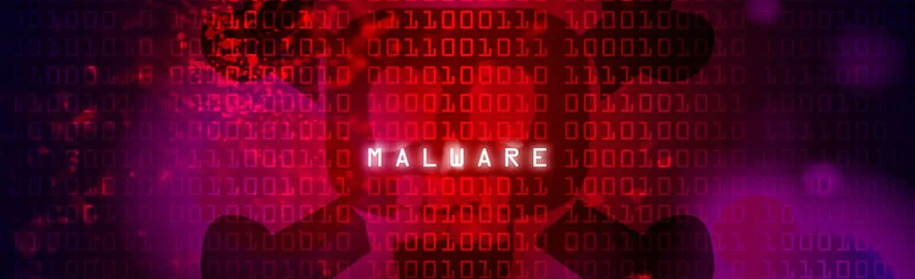
Malwares
Virus
Worm
Logic bomb
Trojan Horse
Back doors/ Trap doors
Zombies
Notes:
Softwares or code snippets used for malicious intent

Slide 6

Virus
A computer virus is a malicious software program loaded onto a user’s computer without the user’s knowledge and performs malicious actions.
piece of code embedded in a legitimate program
created with the ability to self-replicate infecting other programs on a computer.
can remain dormant inside the system and gets activated when you least expect it.
developed to spread from one host to another
It can be sent through email attachments, file downloads, software installations, or unsecured links.
These viruses can steal your data such as passwords, hacked into your social media accounts or online banking accounts, and even wiped out all your data.
Notes:
They are always induced by people. Once created and released, however, their diffusion is not directly under human control. After entering a computer, a virus attaches itself to another program in such a way that execution of the host program triggers the action of the virus simultaneously. It can self-replicate, inserting itself onto other programs or files, infecting them in the process. Not all computer viruses are destructive though. However, most of them perform actions that are malicious in nature, such as destroying data. Some viruses wreak havoc as soon as their code is executed, while others lie dormant until a particular event (as programmed) gets initiated, that causes their code to run in the computer. Viruses spread when the software or documents they get attached to are transferred from one computer to another using a network, a disk, file sharing methods, or through infected e-mail attachments. Some viruses use different stealth strategies to avoid their detection from anti-virus software. For example, some can infect files without increasing their sizes, while others try to evade detection by killing the tasks associated with the antivirus software before they can be detected. Some old viruses make sure that the "last modified" date of a host file stays the same when they infect the file.

Slide 7
Virus
Typical signs of computer virus infections include:
Ongoing crashes and blue screen errors
Slow performance
Missing files
Low storage
Unexpected behavior
Constant browser pop-ups
Unidentifiable programs
Increased network activity
Disabled security software
Notes:
Viruses, by contrast, require that an end-user at least kick it off, before it can try to infect other innocent files and users.

Slide 8
Types
RESIDENT VIRUS: Resident viruses set up shop in your RAM and meddle with your system operations. They’re so sneaky that they can even attach themselves to your anti-virus software files.
MULTIPARTITE VIRUS: This virus infects the entire system. Multipartite viruses spread by performing unauthorized actions on your operating system, folders, and programs.
DIRECT ACTION: This virus targets a specific file type, most commonly executable files (.exe), by replicating and infecting files. Due to its targeted nature, this virus type is one of the easier ones to detect and remove.
BROWSER HIJACKER: Easily detected, this virus type infects your browser and redirects you to malicious websites.
OVERWRITE VIRUS: Like the name implies, overwrite viruses overwrite file content to infect entire folders, files, and programs.
WEB SCRIPTING VIRUS: This sneaky virus disguises itself in the coding of links, ads, images, videos, and site code. It can infect systems when users download malicious files or visit malicious websites.
FILE INFECTOR: By targeting executable files (.exe), file infector viruses slow down programs and damage system files when a user runs them.
NETWORK VIRUS: Network viruses travel through network connections and replicate themselves through shared resources.
BOOT SECTOR VIRUS: One of the easier viruses to avoid, this virus hides out in a file on a USB drive or email attachment. When activated, it can infect the system’s master boot record to damage the system.

Slide 9
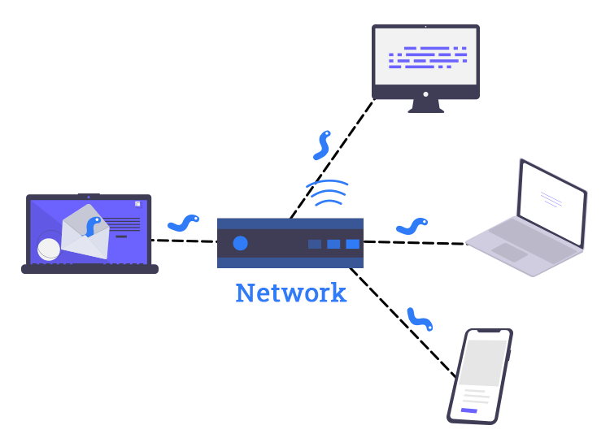
Computer Worms
Worms have been around even longer than computer viruses, all the way back to mainframe days.
Email brought them into fashion in the late 1990s, and for nearly a decade, computer security pros were besieged by malicious worms that arrived as message attachments. One person would open a wormed email and the entire company would be infected in short order.
The distinctive trait of the computer worm is that it's self-replicating.
What makes an effective worm so devastating is its ability to spread without end-user action.
Worms exploit other files and programs to do the dirty work. For example, the SQL Slammer worm used a (patched) vulnerability in Microsoft SQL to incur buffer overflows on nearly every unpatched SQL server connected to the internet in about 10 minutes, a speed record that still stands today.
Notes:
he primary difference between a virus and a worm is that viruses must be triggered by the activation of their host; whereas worms are stand-alone malicious programs that can self-replicate and propagate independently as soon as they have breached the system. Worms do not require activation—or any human intervention—to execute or spread their code.
Ransomware – avoid using backups

Slide 10
Recent Worm Attacks
WannaCry
Stuxnet
Duqu
I Love You Bug
Slammer
NotPetya
Notes:
Similarly, NotPetya the same year infected an accounting program widely used in Ukraine and reached businesses around the globe. Although it, too, caused billions of dollars in damage, it was not believed to be primarily designed to make money. A security report examining the attack said it did not appear to be designed for "coercion or conquest." A University of California Berkley computer scientist called the attack "a deliberate, malicious, destructive attack or perhaps a test disguised as ransomware."
Microsoft urged all users of Windows 10 versions 1903 and 1909 and Windows Server versions 1903 and 1909 to instal patches.
In 2017, a ransomware worm called WannaCry encrypted data on more than 200,000 computers in 150 countries and issued demands ransom using Bitcoin cryptocurrency. An emergency patch was distributed within days and a kill switch implemented that halted the worm's spread. But experts say damages may have reached as high as billions of dollars. The attack was believed to have been launched from North Korea.
Iloveyou worm: When it went off, it hit nearly every email user in the world, overloaded phone systems (with fraudulently sent texts), brought down television networks, and even delayed daily afternoon paper for half a day.
Several other worms, including SQL Slammer and MS Blaster, ensured the worm's place in computer security history.

Slide 11
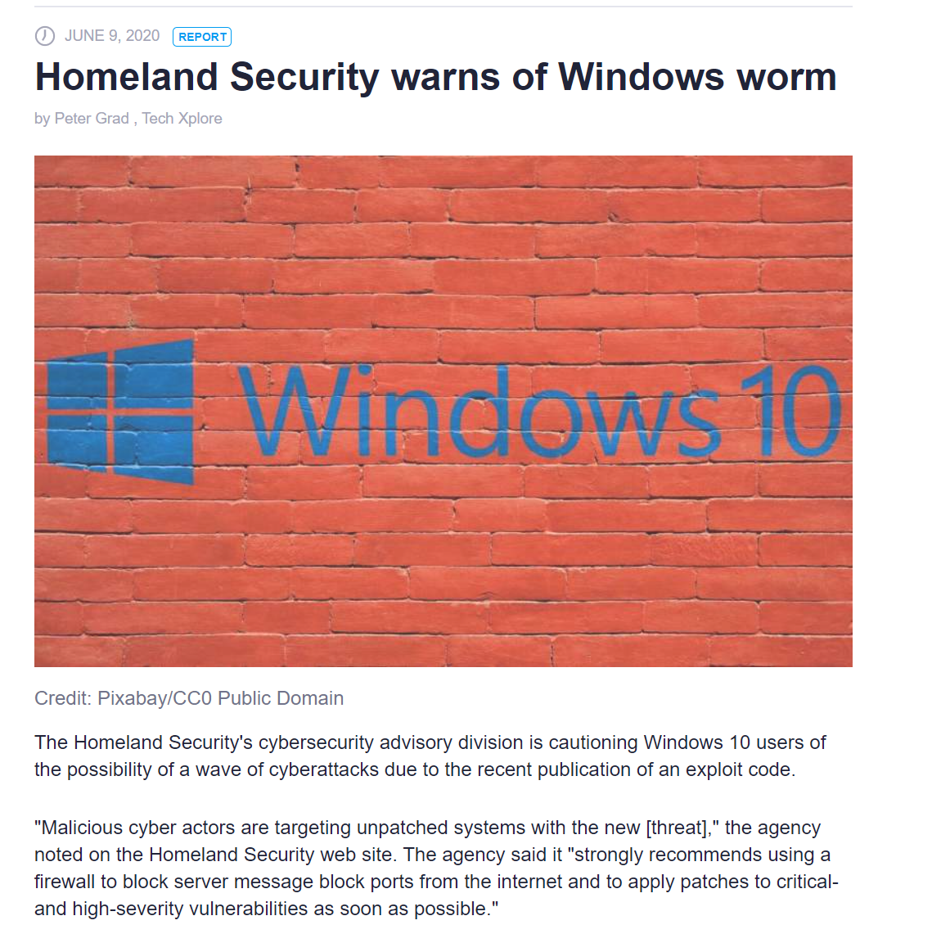

Slide 12
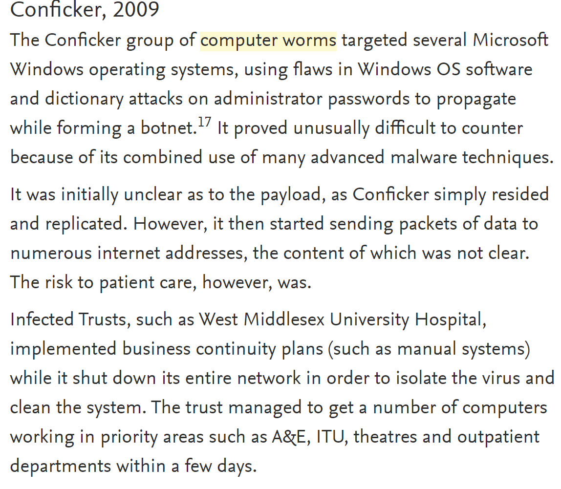

Slide 13
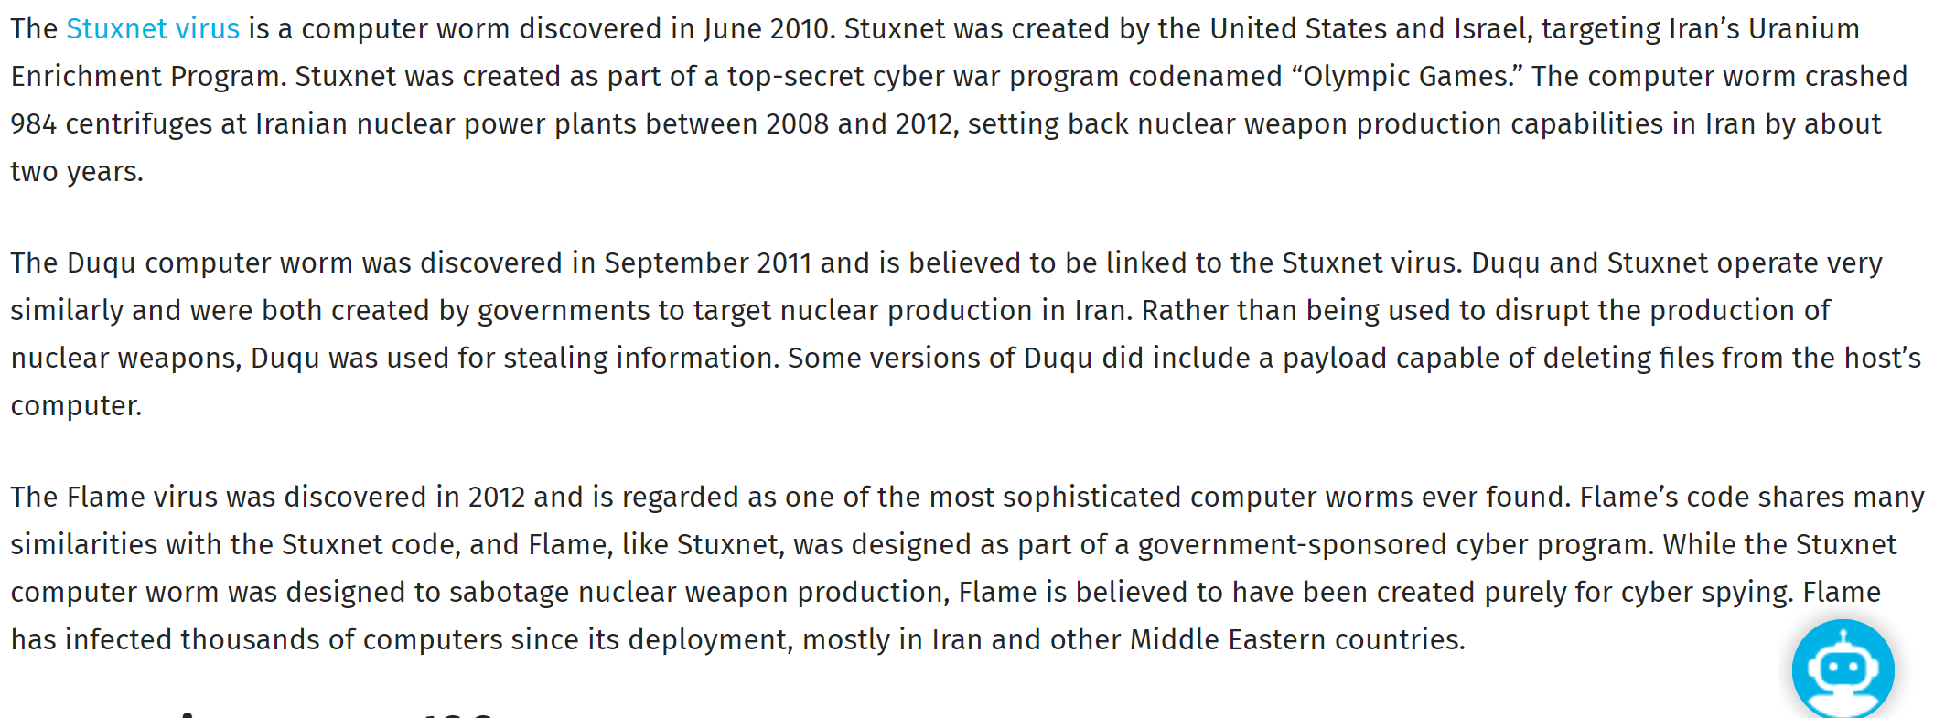

Slide 14
Symptoms of Computer Worm
Here are some of the typical symptoms of a computer worm:
Slow computer performance
Freezing/crashing
Programs opening and running automatically
Irregular web browser performance
Unusual computer behavior (messages, images, sounds, etc)
Firewall warnings
Missing/modified files
Appearance of strange/unintended desktop files or icons
Operating system errors and system error messages
Emails sent to contacts without the user’s knowledge
While other issues can cause these symptoms, the appearance of multiple symptoms from this list or the repeated occurrence of certain symptoms usually indicates that the computer has been infected with a worm.

Slide 15
Protection against worms
Keep the computers’ operating system and software up-to-date with vendor-issued security releases. These updates often contain security patches designed to protect computers from newly discovered worms.
Avoid opening emails that you don’t recognize or expect, as many computer worms spread via email.
Refrain from opening attachments and clicking on links from untrusted/unfamiliar sources.
Run a firewall and antivirus software to be further protected from computer worms. Software firewalls will keep the computer protected from unauthorized access. Choose an antivirus program that includes download scanning functionality (to detect malicious content in email and web downloads) as well as malware removal tools.

Slide 16
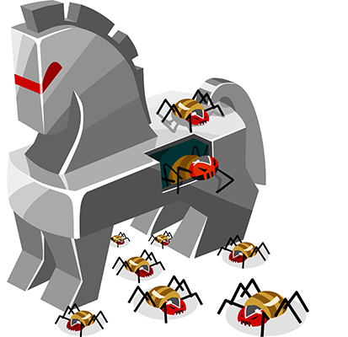
Trojans
Trojans masquerade as legitimate programs, but they contain malicious instructions.
They've been around forever, even longer than computer viruses, but have taken hold of current computers more than any other type of malware.
A Trojan must be executed by its victim to do its work.
Trojans usually arrive via email or are pushed on users when they visit infected websites.
The most popular Trojan type is the fake antivirus program, which pops up and claims you're infected, then instructs you to run a program to clean your PC. Users swallow the bait, and the Trojan takes root.
Remote Access Trojans allow the attacker to take remote control over the victim’s computer.
This type of Trojan is designed to avoid detection.
Trojans are hard to defend against for two reasons:
They're easy to write (cyber criminals routinely produce and hawk Trojan-building kits) and spread by tricking end-users — which a patch, firewall, and other traditional defense cannot stop.
Malware writers pump out Trojans by the millions each month. Antimalware vendors try their best to fight Trojans, but there are too many signatures to keep up with.
Notes:
Remote access Trojans (RATs) in particular have become popular among cybercriminals. RATs allow the attacker to take remote control over the victim's computer, often with the intent to move laterally and infect an entire network. This type of Trojan is designed to avoid detection. Threat actors don't even need to write their own. Hundred of off-the-shelf RATs are available in underground marketplaces

Slide 17
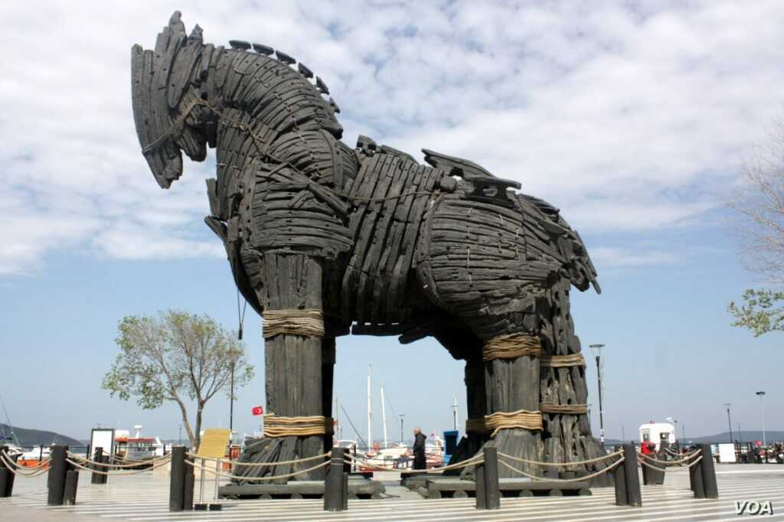

Slide 18
Backdoor/Trapdoor
A backdoor refers to an undisclosed point of access to a program, application, or computer system in which the standard security procedures and authentication processes are bypassed.
A backdoor virus, therefore, is a malicious code, which by exploiting system flaws and vulnerabilities, is used to facilitate remote unauthorized access to a computer system or program.

Slide 19
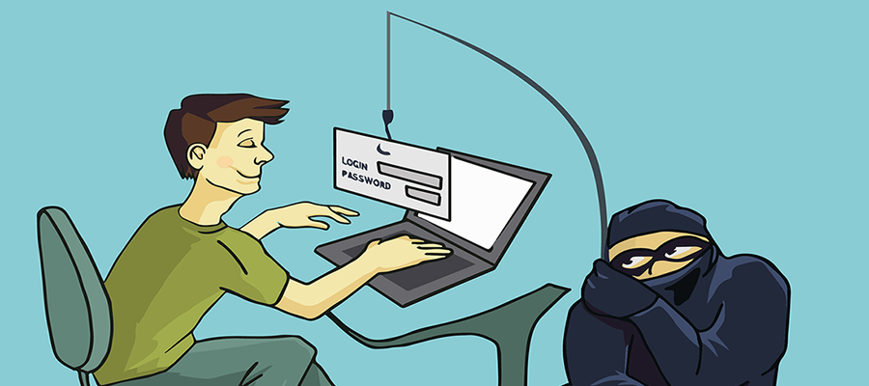
Spyware
Spyware is most often used by people who want to check on the computer activities of loved ones. Of course, in targeted attacks, criminals can use spyware to log the keystrokes of victims and gain access to passwords or intellectual property.
Adware and spyware programs are usually the easiest to remove, often because they aren't nearly as nefarious in their intentions as other types of malware. Find the malicious executable and prevent it from being executed — you're done.
A much bigger concern than the actual adware or spyware is the mechanism it used to exploit the computer or user, be it social engineering, unpatched software, or a dozen other root exploit causes. This is because although a spyware or adware program’s intentions are not as malicious, as say, a backdoor remote access trojan, they both use the same methods to break in. The presence of an adware/spyware program should serve as a warning that the device or user has some sort of weakness that needs to be corrected, before real badness comes calling.

Slide 20
Adware
If you're lucky, the only malware program you've come in contact with is adware, which attempts to expose the compromised end-user to unwanted, potentially malicious advertising.
A common adware program might redirect a user's browser searches to look-alike web pages that contain other product promotions.

Slide 21
Malvertising
Not to be confused with adware, malvertising is the use of legitimate ads or ad networks to covertly deliver malware to unsuspecting users’ computers.
For example, a cybercriminal might pay to place an ad on a legitimate website. When a user clicks on the ad, code in the ad either redirects them to a malicious website or installs malware on their computer.
In some cases, the malware embedded in an ad might execute automatically without any action from the user, a technique referred to as a “drive-by download.”
Cybercriminals have also been known to compromise legitimate ad networks that deliver ads to many websites. That’s often how popular websites such as the New York Times, Spotify and the London Stock Exchange have been vectors for malicious ads, putting their users in jeopardy.
The goal of cybercriminals who use malvertising is to make money, of course.
Malvertising can deliver any type of money-making malware, including ransomware, crypto-mining scripts or banking Trojans.

Slide 22
Logic bombs
A logic bomb is a piece of code intentionally inserted into a software system that will set off a malicious function when specified conditions are met.
For example, a programmer may hide a piece of code that starts deleting files, should they ever be terminated from the company

Slide 23
Zombies
In computing, a zombie is a computer connected to the Internet that has been compromised by a hacker, computer virus, computer worm, or trojan horse program and can be used to perform malicious tasks of one sort or another under remote direction.
Used in:
DDoS attack
Degradation of Service

Slide 24
Mining Malwares
Hackers are placing crypto mining software on devices, networks, and websites at an alarming rate.
Hackers are turning to cryptojacking — infecting enterprise infrastructure with crypto mining software — to have a steady, reliable, ongoing revenue stream. As a result, they're getting very clever in hiding their malware.
Notes:
https://www.csoonline.com/article/3267572/how-to-detect-and-prevent-crypto-mining-malware.html

Slide 25
Hybrid and exotic forms
Today, most malware is a combination of traditional malicious programs, often including parts of Trojans and worms and occasionally a virus. Usually the malware program appears to the end-user as a Trojan, but once executed, it attacks other victims over the network like a worm.
Many of today's malware programs are considered rootkits or stealth programs. Essentially, malware programs attempt to modify the underlying operating system to take ultimate control and hide from antimalware programs. To get rid of these types of programs, you must remove the controlling component from memory, beginning with the antimalware scan.
Bots are essentially Trojan/worm combinations that attempt to make individual exploited clients a part of a larger malicious network. Botmasters have one or more "command and control" servers that bot clients check into to receive their updated instructions. Botnets range in size from a few thousand compromised computers to huge networks with hundreds of thousands of systems under the control of a single botnet master. These botnets are often rented out to other criminals who then use them for their own nefarious purposes.

Slide 26
Fileless malware
Fileless malware isn’t really a different category of malware, but more of a description of how they exploit and persevere. Traditional malware travels and infects new systems using the file system.
Fileless malware, which today comprises over 50 percent of all malware and growing, is malware that doesn’t directly use files or the file system. Instead they exploit and spread in memory only or using other “non-file” OS objects such as registry keys, APIs or scheduled tasks.
Many fileless attacks begin by exploiting an existing legitimate program, becoming a newly launched “sub-process,” or by using existing legitimate tools built into the OS (like Microsoft’s PowerShell). The end result is that fileless attacks are harder to detect and stop. If you aren’t already very familiar with common fileless attack techniques and programs, you probably should be if you want a career in computer security.
Notes:
Cache poisoning

Slide 27
Finding and removing Malwares
Unfortunately, finding and removing individual malware program components can be a fool's errand. It's easy to get it wrong and miss a component. Plus, you don't know whether the malware program has modified the system in such a way that it will be impossible to make it completely trustworthy again.
Unless you're well trained in malware removal and forensics,
back up the data (if needed),
format the drive, and
reinstall the programs and data when you find malware on a computer.
Patch it well and
make sure end-users know what they did wrong.
That way, you get a trustworthy computer platform and move ahead in the fight without any lingering risks or questions.

Slide 28

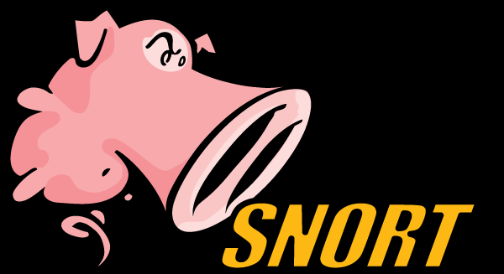
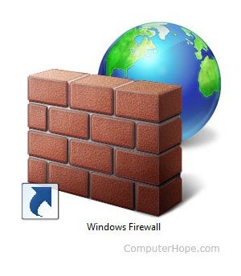
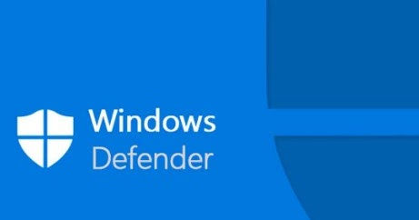
Security
Intrusion Detection System IDS
Intrusion Prevention System - IPS
Firewalls
Anti Virus and Anti Malware
Explore snort: An Intrusion prevention system for malicious activities on the network

Slide 29
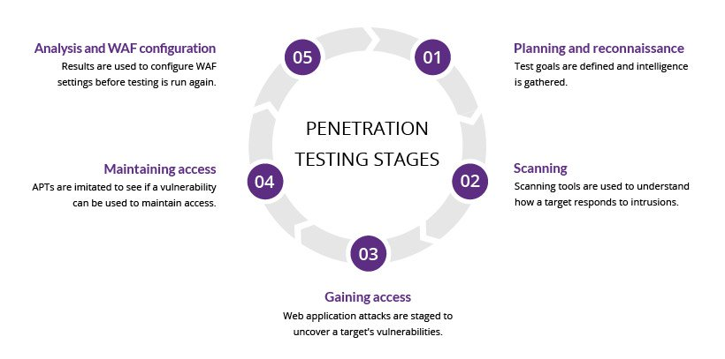
Penetration Testing

Slide 30
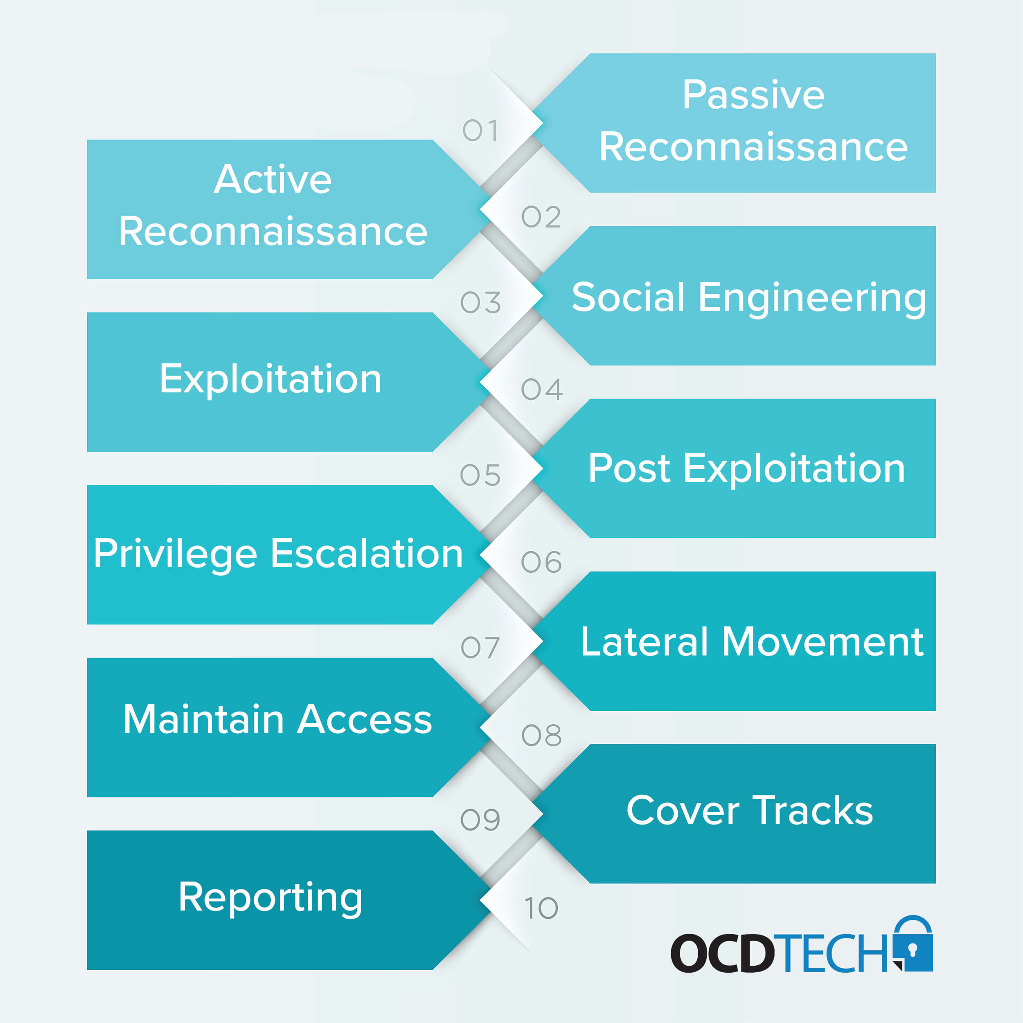

Slide 31

Activity Reconnaisance
Google Search Engine – Reconnaisance
Special Characters
Google Dorks / Google Hacking Database
Snort
Nmap – cmd
Wireshark
Notes:
Modifying and Viewing ARP table
CMD
arp –a
arp –s IP Address Mac Address (Modify arp entry)
arp –d IP Address (Deleting arp entry)

Slide 32
Importance of updates and patches
Windows 10 security
Linux Security
Notes:
Access Control and Roles assignment Mandatory Access Control and Discretionary Access Control

Slide 33
References
https://pentest-tools.com/information-gathering/google-hacking
https://ahrefs.com/blog/google-advanced-search-operators/
https://www.youtube.com/watch?v=-igzoRRTXnM
https://www.csoonline.com/article/2615925/security-your-quick-guide-to-malware-types.html
https://hightouchtechnologies.com/9-common-types-of-computer-viruses/
https://www.csoonline.com/article/2615925/security-your-quick-guide-to-malware-types.html
https://www.sciencedirect.com/topics/computer-science/computer-worms
https://www.exploit-db.com/
https://us.norton.com/internetsecurity-malware-what-is-a-trojan.html#:~:text=A%20Trojan%20is%20designed%20to,the%20malware%20on%20your%20device.&text=Viruses%20can%20execute%20and%20replicate%20themselves.

